Slide 1

Teaching with AI
Experience and future directions
Fabrício Góes / Marco Volpe

Slide 2
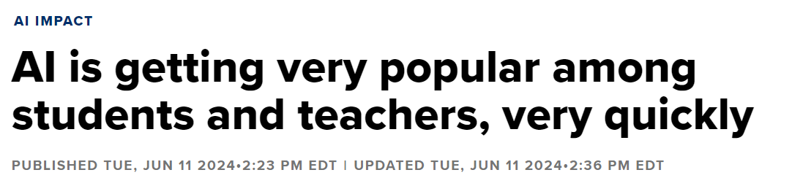
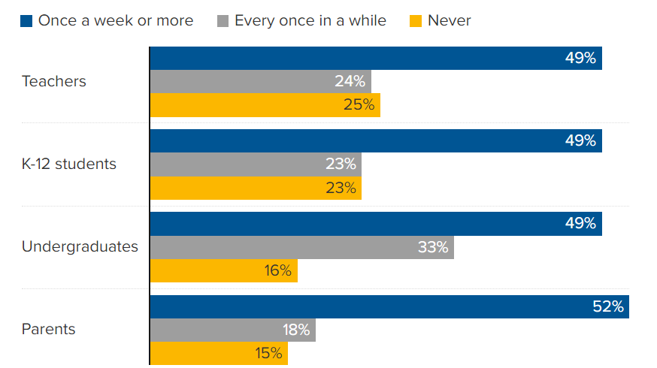
Context
Online survey of 4,007 teachers, parents and students in the U.S. (May 2024)
About half of teachers, students and parents use AI chatbots at least once a week for work/school.
https://www.cnbc.com/2024/06/11/ai-is-getting-very-popular-among-students-and-teachers-very-quickly.html

Slide 3
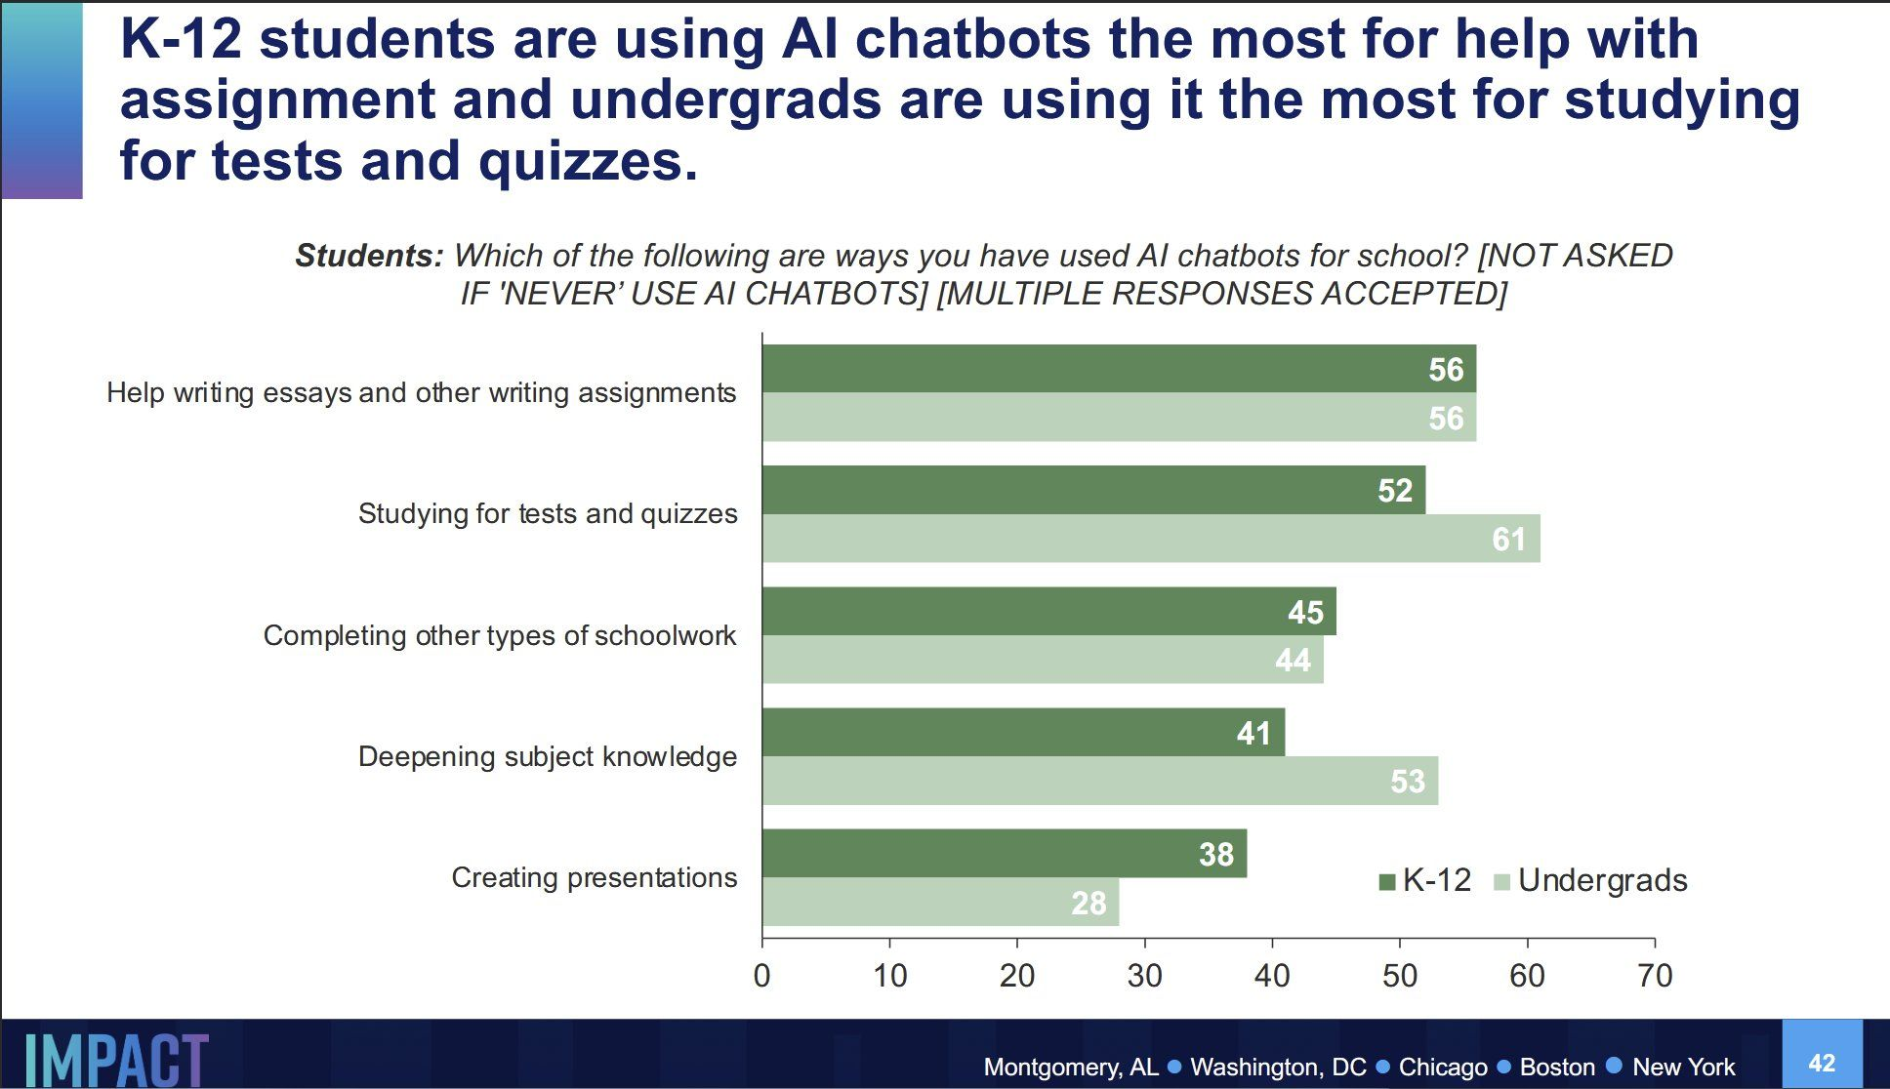
How are students using AI?

Slide 4
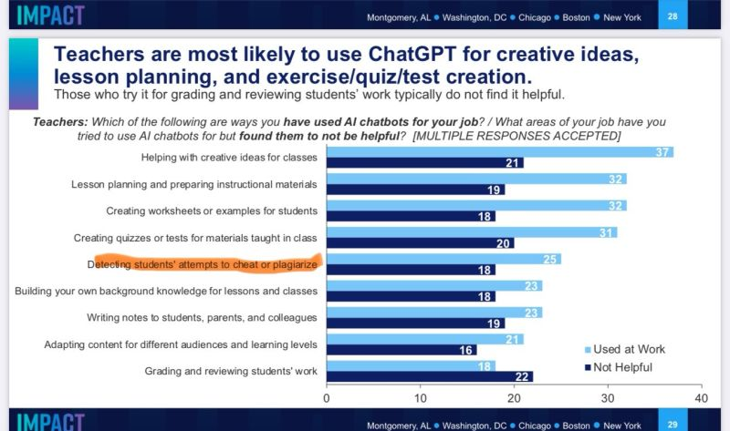
How are teachers using AI?

Slide 5
And in the UK?
Survey from Higher Education Policy Institute on 1,250 UG students in the UK (Feb 24)
53% have used AI to help them with assessments.
The most common use is as an ‘AI private tutor’ (36%), helping to explain concepts.
13% use AI to generate text for assessments, but they typically edit the content before submitting it.
35% of students who have used AI do not know how often it produces made-up facts, statistics or citations.
A ‘digital divide’ in AI use may be emerging. 58% of students from the most privileged backgrounds use AI for assessments, compared with just 51% from the least privileged backgrounds.
A majority (63%) think their institution has a ‘clear’ policy on AI use.
Institutions have not radically changed their approach to assessments, with only 9% students saying the approach has changed ‘significantly’, compared with 24% who say it has stayed the same.
Most students (65%) also think their institution could spot AI work.
https://www.hepi.ac.uk/2024/02/01/new-hepi-policy-note-finds-more-than-half-of-students-have-used-generative-ai-for-help-on-assessments-but-only-5-likely-to-be-using-ai-to-cheat/

Slide 6
AI Detection

Slide 7
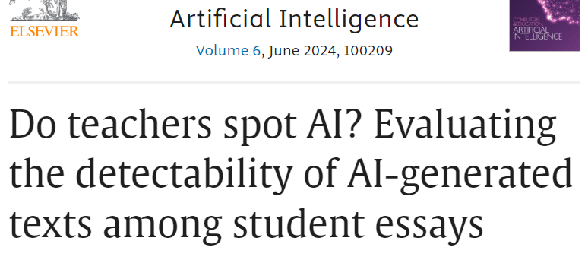
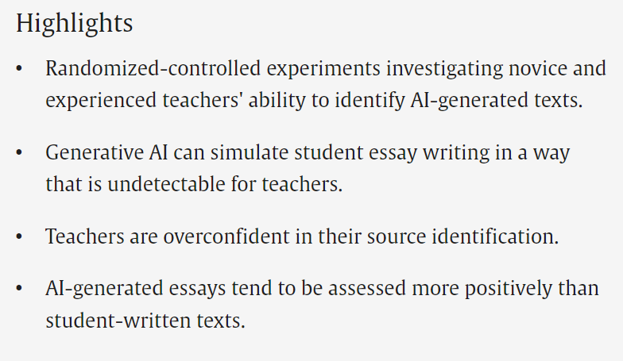
Can teachers spot AI?
https://www.sciencedirect.com/science/article/pii/S2666920X24000109

Slide 8
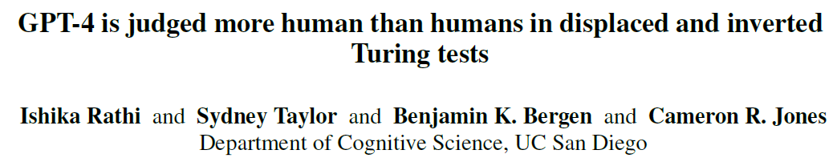
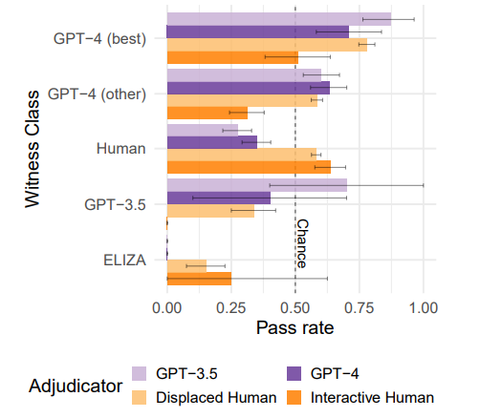
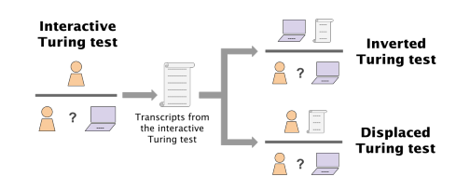
Is AI better than humans at spotting AI?
https://arxiv.org/pdf/2407.08853

Slide 9
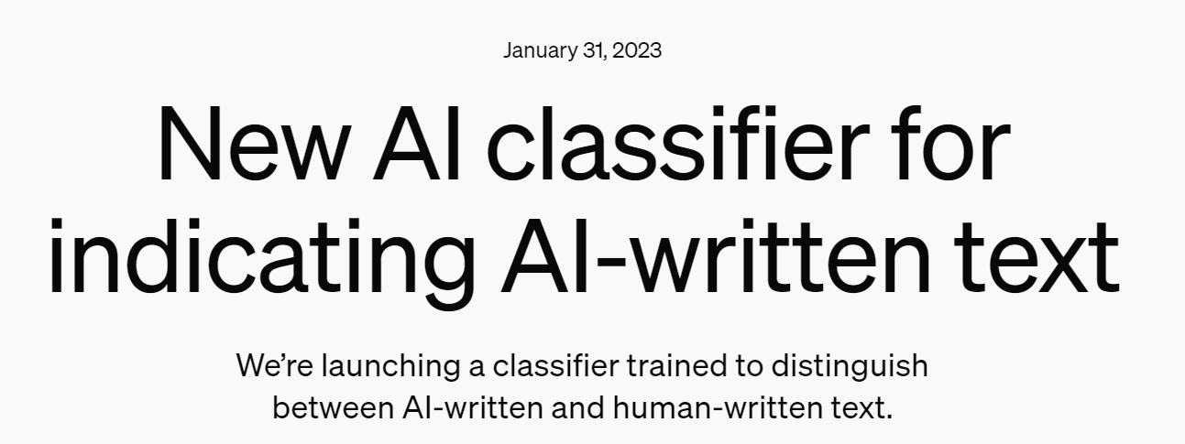

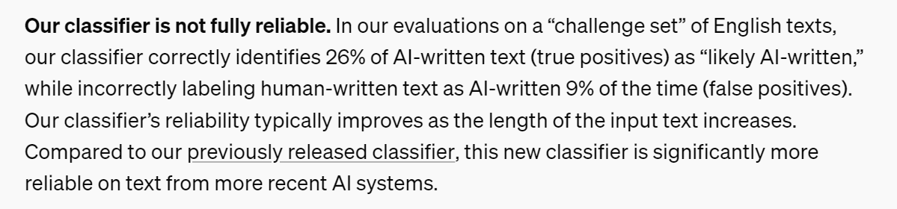
Can OpenAI detect AI?

Slide 10

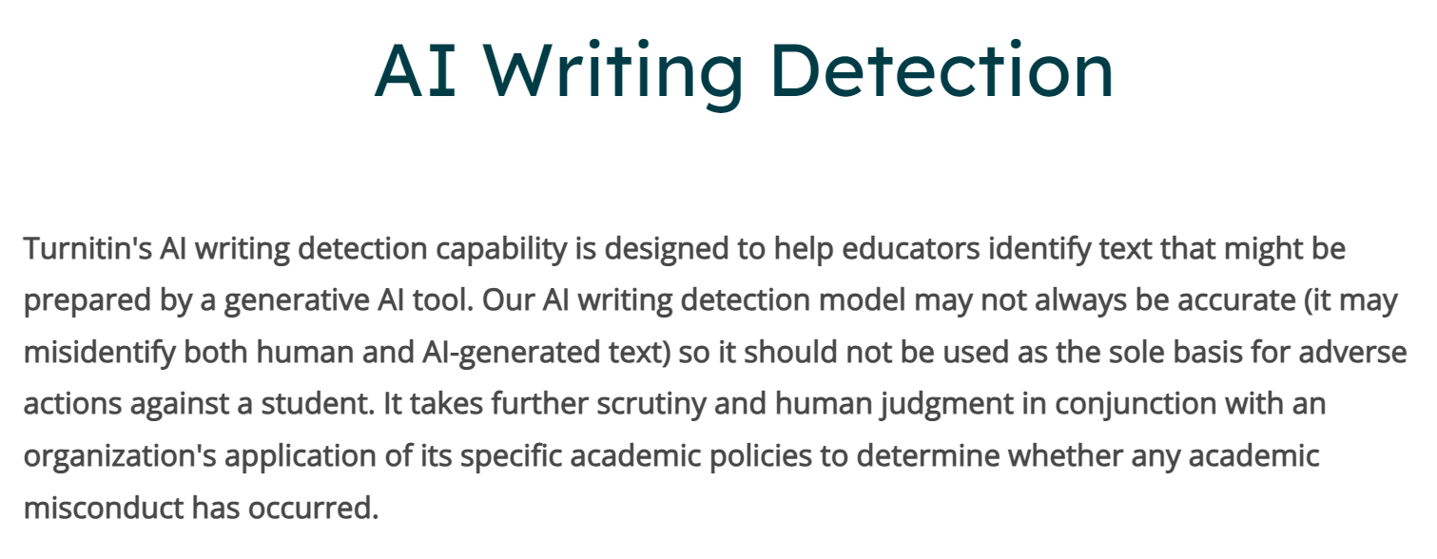
Can Turnitin detect AI?
https://help.turnitin.com/ai-writing-detection.htm
https://www.degruyter.com/document/doi/10.1515/opis-2022-0158/html

Slide 11

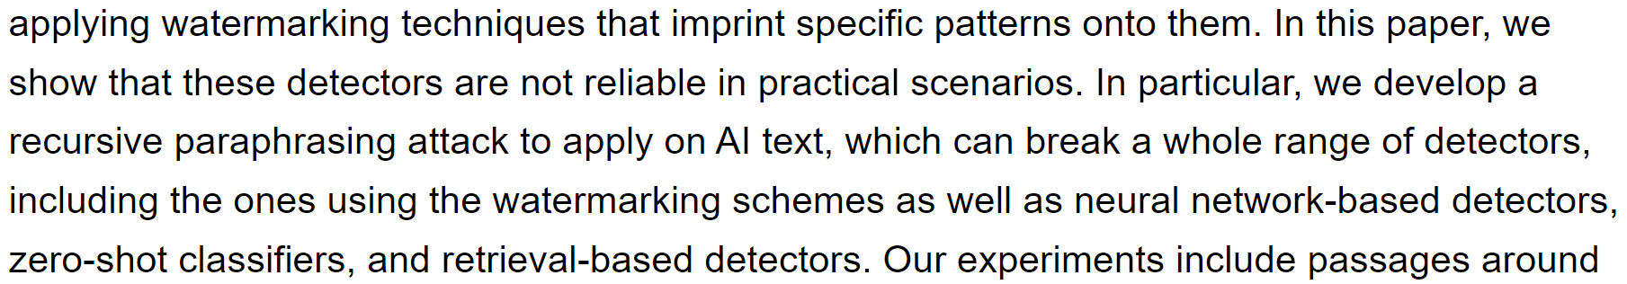
Breaking AI text detection
https://arxiv.org/abs/2303.11156

Slide 12
AI Text Detection is a Hard Problem
Advanced technology – AI-generated text can be highly sophisticated and human-like.
Evolving technology – AI models continuously evolve, keeping detection methods playing catch-up.
Diversity of models – There are several LLMs around and they have all been trained on different data.
Context/Style Shifting – AI can adapt to various styles and contexts, making detection harder.
Mixed authorship – Texts can combine AI-generated and human content (even small tweaks).
Automated AI text detection is not 100% reliable – it would require human revision, which is also unreliable.

Slide 13
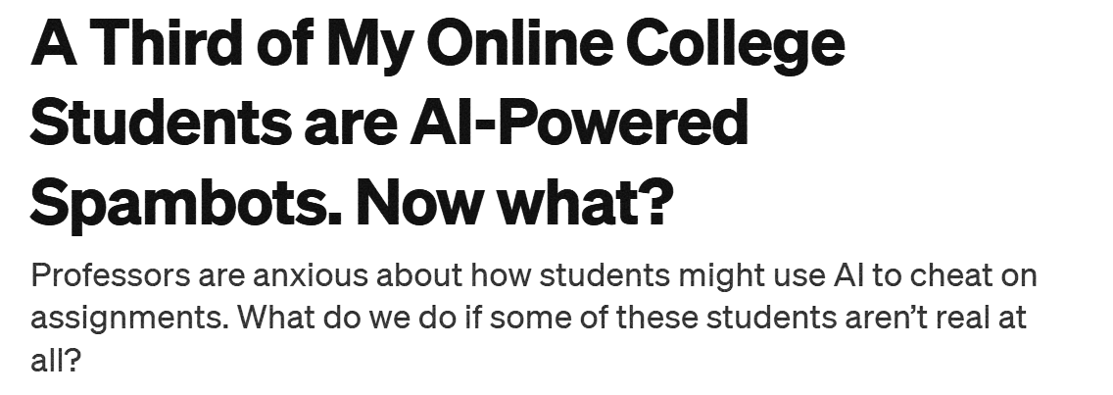
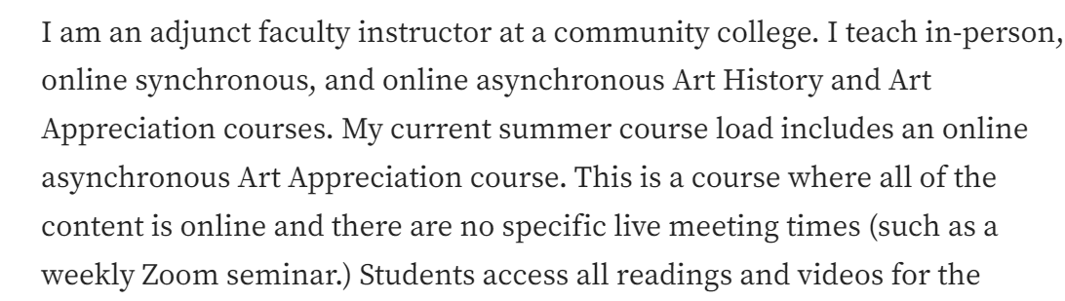
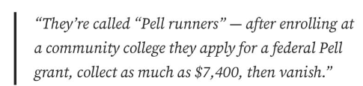
Can teachers spot AI students?
https://medium.com/@marginaliant/a-third-of-my-online-college-students-are-ai-powered-spambots-now-what-91c6e34b5d11

Slide 14
Experience using AI on BSc in Creative Computing

Slide 15
What is the BSc in Creative Computing?
It is a multi-disciplinary and inclusive course on Applied Computing, where students learn how to develop applications such as games, interactive attractions, virtual reality experiences etc.
Students develop programming skills but their interest usually lies in the humanities and arts.
Students also attend to modules in other departments and we are eager to also welcome students from other departments to attend our modules.
We’ve been embeding AI in our modules for the last 3 years, even before ChatGPT was released.

Slide 16
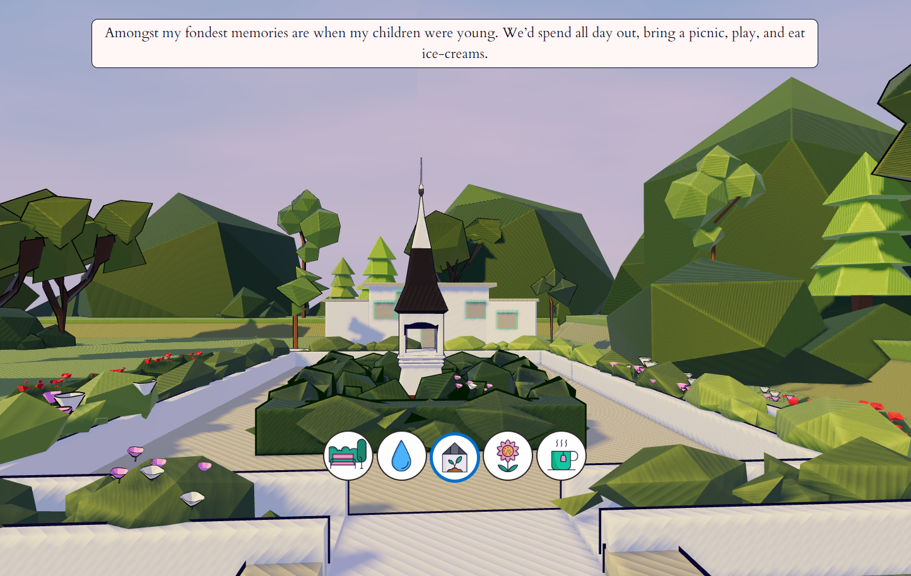
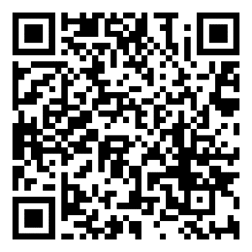
Welland Park Experience (Market Harborough Museum)
https://www.cultureleicestershire.co.uk/exhibitions/harborough/
https://tnm6.github.io/mh15/

Slide 17
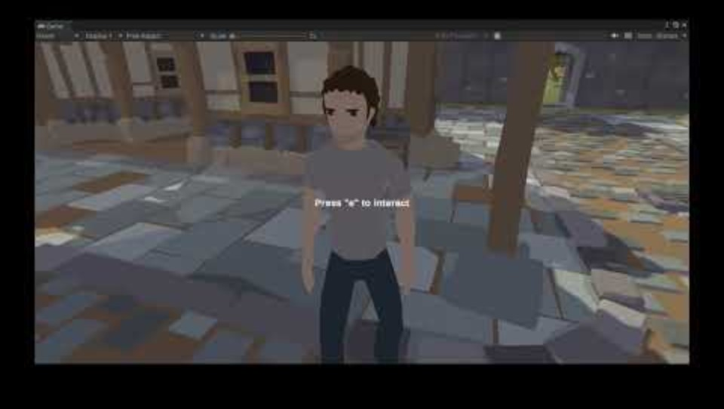
The Disappearance of Dr Winston (AI RPG Game)

Slide 18
AI in our modules (2023/2024)
Creativity and Computing (Year 1)
Introduce the fundamentals about Creativity and how it intersects with Computing
Assessment: Essay, Essay Plan Presentation
Concurrent Design (Year 2)
Applied module where students in groups learn how to develop a prototype of an attraction to a real client (usually the National Space Centre).
Assessment: Product Development, Presentation (in person) and Progress Reports
Computational Creativity (Year 3)
Prompt Engineering to develop AI applications for the creative domain.
Assessment: Weekly Practical Exercises, Project Development

Slide 19
Creativity and Computing

Slide 20
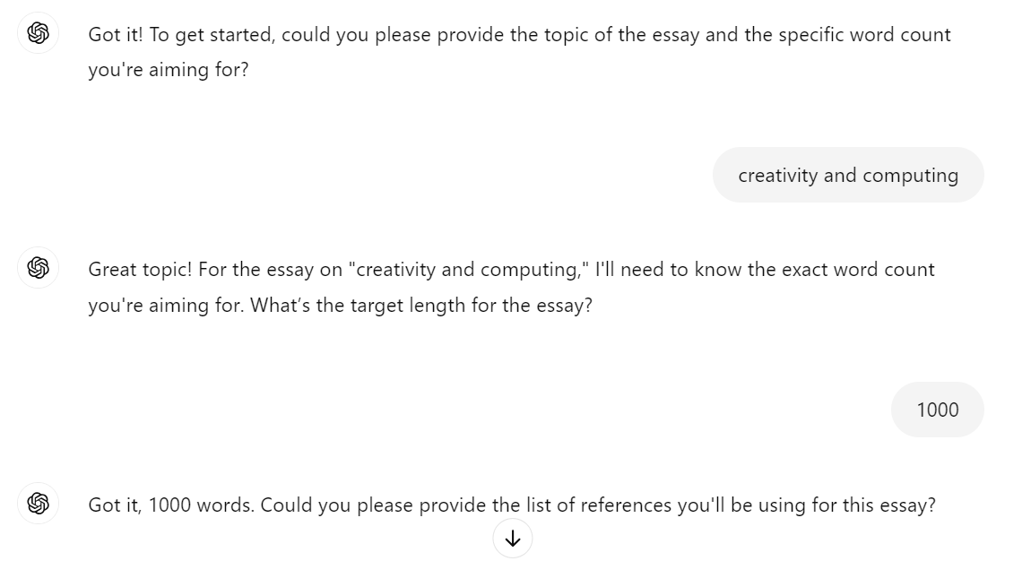

Creativity and Computing
We start by providing the ultimate prompt for generating an essay automatically to make them aware that you know about AI. Then we ask them to generate an essay using it on ChatGPT.
Act as an undergraduate student, your job is to create an essay in academic style about a topic with a certain word count. I will provide you a list of references and you should use only them. The focus of the essay should be supported by the references provided. It should have a references section at the end in a specific reference style. You should ask me as many questions as necessary to do the job. You should ask one question at a time, and I will respond to each question. When you have enough information to generate the essay, you should generate it. Do you understand?

Slide 21
Creativity and Computing
Then, they are asked to reflect (critical thinking) about the generated essay:
What is the quality level of it?
Can you do better than that?
Do you think you would get a high mark for this essay?
Lastly, we present to them the weaknessess of the model and how we can say that this looks like AI generated.
We incetivize them to use Generative AI, rather than ban it.

Slide 22
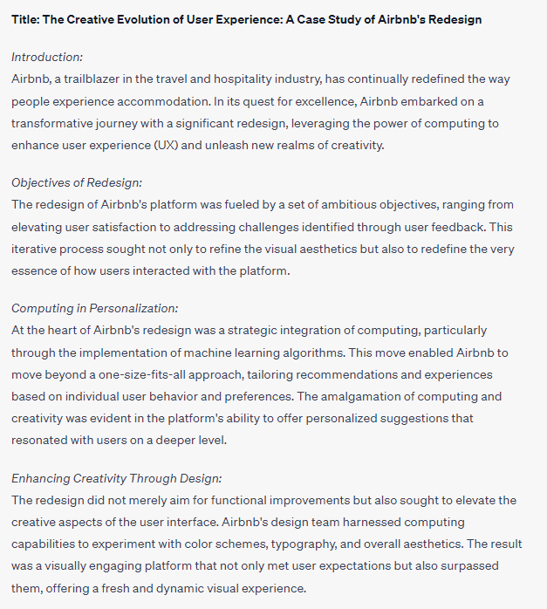
Creativity and Computing
Where are the references? How do you know it is true?
GPT style usually uses “:”, someone would suspect is GPT generated.
Amalgamation is not commonly used. GPT exaggerates or use uncommon vocabulary.
Single paragraph for each topic is not long enough.

Slide 23
Creativity and Computing
Provide guidelines on how to use it:
Start writing a sentence and ask it to complete
Read the sentence and improve it with your writing skills
You should control the flow (direction) of the text (not GPT)
This is a support tool for writing an essay (think as an advanced writing assistant)
Make them aware of the risks of using AI
GPT-3 was tested with groups of students and teachers (GPT 4 is probably better)
It didn’t get an “A” grade on any assignment
Most of the time it got “C” or “D”
There is no guarantee that the generated text is not a copy (plagiarism) of other work (Turnitin can still detect plagiarism)
If you don’t know how to use it properly, it might take more time than writing excellent text on your own

Slide 24
Creativity and Computing (Assessment)
Students write their essays during the weekly seminar session.
We try to sit and discuss with each student about their progress in a weekly basis.
They must deliver an essay plan (30%) which consists of the main ideas, arguments and structure of the essay in the form of a video recording over slides.
The final essay (70%) is a traditional essay of no more than 8 pages. They submit only the text through Turnitin (detects only plagiarism, not AI-generated). Students are required to report how and where they used Generative AI.

Slide 25
Creativity and Computing (Pros and Cons)
Pros
Students are treated as responsible adults (awareness of the risks and benefits of using generative AI)
Students are still supervised during the essay writing informally
Essay plan presentation still requires them to work on it
Cons
No way to prove that the final essay was not AI-generated
Presentations even with video and voice are not AI-proof

Slide 26
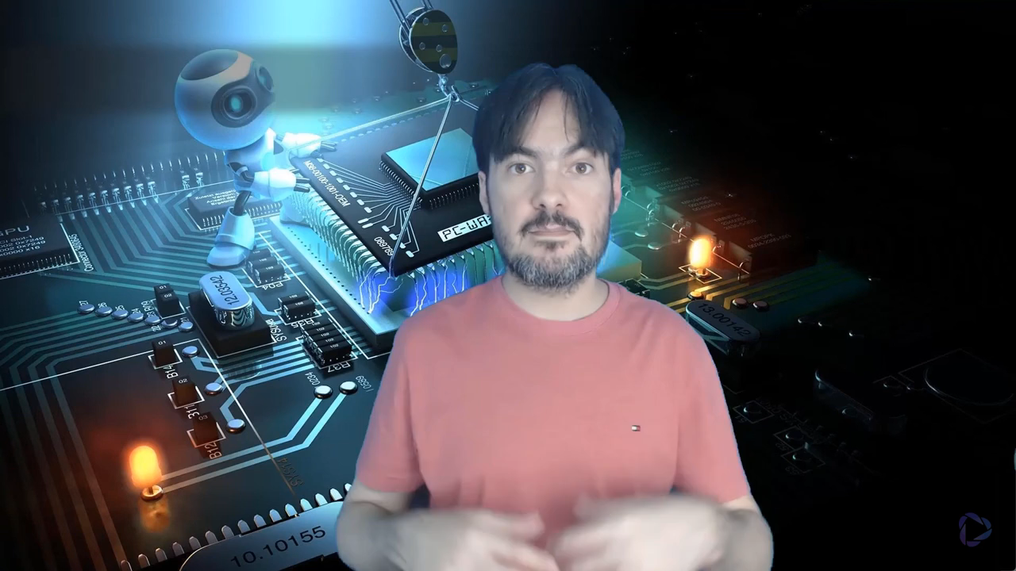
Presentations are not AI-proof - AI Generated Voice
It was originally recorded in Portuguese. It translates to English using my own voice and accent.

Slide 27
AI Tools for Voice Cloning
HeyGen (https://app.heygen.com/) – used in the previous slide
Descript
Fliki
Murf AI
PlayHT
Elevenlabs
Lovo.ai

Slide 28
How can we address the Cons? (Traditional Way)
More responsability: In the final essay, we can ask students to sign a declaration that all AI-generated text has been referenced.
More supervision: Students must submit the progress of their essay on a weekly basis as a way for us to generate evidence of their progress. This will be a criterion in the rubric.
Add AI rubric criterion: Students must use AI more like a Cyborg (hybrid text) than a Centaur (AI write some full parts and the student write others – advanced copy and paste).
More weight on other criteria: Creativity, originality and style could become more important than be grammatically correct. It depends entirely on your module ILOs.

Slide 29
The Next Level – Integrating AI in the loop
AI as a Supervisor (used during the essay writing)
Craft a prompt for an “essay supervisor” persona (Socratic style)
Students must submit their dialogues with their “essay supervisor” in a weekly basis as evidence that they have been working on their essay
Craft a prompt to summarize and highlight main aspects in the dialogues that are important to support your marking and feedback
Add a criteria into the rubric on “interaction with AI supervisor”
AI as an Examiner (used in the final essay submission)
Craft a prompt of an “examiner” persona
Students must upload their essay and use the prompt and go through an interview about their essay
Students will submit the interview dialogue along with the essay

Slide 30
Concurrent Design

Slide 31
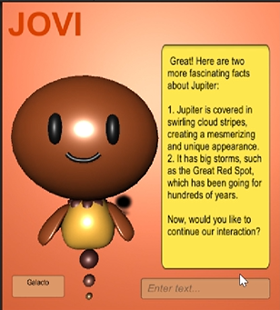
Concurrent Design
Students had to develop AI avatars in groups of 5 students (each with a different role) to the National Space Centre.
They had to use Generative AI in anyway they could, including the core of the application.
AI still cannot produce this kind of complex application that requires the use of many different technologies (animation, gaming, chating etc.).
It is expected that students use some code generated by AI, but it will be a minor part of the project.

Slide 32
Concurrent Design (Assessment)
Students have to produce a Business Plan Deck (50%) and a Prototype (50%).
They have meetings with the module convenor and have to submit weekly reports on what they have done, what they are planning to do and any issues preventing them to move forward. They have 3-hour group sessions to develop the project.
The rubric criteria for evaluation involves Teamwork and Sprints (tasks done per week per group member).
The final prototype and business deck are submitted with a video presentation and code, but they also have a in-person presentation involving the client (NSC).

Slide 33
Concurrent Design (Pros and Cons)
Pros
AI enables students to do a project more complex than the ones they used to do.
In-person presentation with external client makes students take the project more seriously and lecturers can argue students.
Weekly meetings with students ensure that they are on track and lecturers can check their actual progress.
AI supports a lot students on coding issues
Cons
Once AI becomes more proficient at coding those complex systems, we might need to introduce oral examination (interviews) about the final code submitted.

Slide 34
The Next Level – Integrating AI in the loop
AI as a Client
Craft a prompt for a “client” persona and students can use it to interview and collect requirements for the development of the prototype.
Students can also ask for feedback on their current project.
AI as a Colleague
Craft a prompt for each role in the group (developer, designer, leader, business person etc.).
This enables group work as an individual assessment, where students interact with their virtual group members. All interactions are submitted as evidence.
AI as a Manager
Craft a prompt for a “manager” persona, who monitors the performance of a group of students and assign tasks.

Slide 35
Computational Creativity

Slide 36
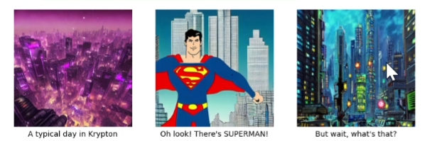
Computational Creativity
Students have also to develop a group project using Generative AI. Each student has a different role as in Concurrent Design. They have weekly supervision meetings in project supervision sessions.
Differently from Concurrent Design, students have to do weekly experiments using Prompt Engineering techniques in the creative domain and write a short reflection about the results achieved. This is done during lab sessions and involves the generation and evaluation of:
Poetry
Jokes
Narrative (Stories)
AI gallery exhibition, comics
Creativity tests

Slide 37
Computational Creativity (Assessment)
Students have to produce a Prototype (70%) and a Portfolio (30%).
The Prototype is similar to the one in Concurrent Design.
The Portfolio is the set of weekly experiments and is marked based on the prompts generated, dialogues with the models and student’s reflection (video and text).
The rubric criteria has a single criteria that reflects the overall quality of the weekly experiments submissions.

Slide 38
Computational Creativity (Pros and Cons)
Pros
Students are focused on learning Prompt Engineering and how to apply it to build a real-world application.
Students are required to use AI, so no major worries about AI-generated content.
Cons
As students get more proficient in using AI, the module has to shift its content to more advanced techniques.
Constant update of the material.
Students are limited by using free models and their limitations. Most students end up paying for unlimited use of the latest and most advanced AI models.

Slide 39
The Next Level – Integrating AI in the loop
AI as a Task/Exercise
Instead of writing a problem statement in a list of exercises, we move to crafting prompts of personas and students must talk to those personas to solve a problem or create an artifact.
Interview a historical figure or Darth Vader
Discuss and evaluate the jokes created by a particular comedian
Critique and ask their opinion on stories created by a particular writer
Come up with a new idea for a movie by discussing with a particular film director
AI as Peers/Advisors/Audience/Auditors
Craft prompts of people with different backgrounds and opinions and ask them to provide feedback on the student work.

Slide 40
Practical Challenges

Slide 41
Challenges for The Next Level
There is no University’s platform where you can craft your AI assistants and students can use them for free, making it hard to monitor all students interactions with the AI.
The closest existing system that does it is Khanmigo from Khan Academy, but it isn’t available in the UK (https://www.khanmigo.ai/).
Subscriptions to the latest AI models are around £20 per month, which can be expensive for some students.

Slide 42
Discussion
Assessments can be more resistant to AI cheating using traditional methods by adding:
More responsability
More supervision
More rubric criteria (AI criteria included)
More evidence (dialogues)
In practice, we haven’t had any major issue using AI in our modules.
In order to fully use the power of AI as an true assistant, we need more institutional support and infrastructure. Still, we can move to the next level without it.
The more you evaluate the final product instead of the process, the more vulnerable you will be to AI-generated content.
It is a good time to experiment new approaches with AI.

